Slide 1

SALES PEFORMANCE METRICS
A RESEARCH BY BASAVA SANKETH BN

Slide 2
OBJECTIVE
Analysing the sales performance which are present in sales performance metrics data using various excel tools.
We will try to answer some business question like:
Total earnings from the sales.
About the fee status – no. of paid and not paid.
Top 5 consultant sales revenue.
Total earnings by month.
Enrolled courses per month.
Top 5 training levels.
Avg. paid calls by month.
Total sales by sales team.
Advertising spend broken down by channels.
Avg. calls by month.

Slide 3
Business question to be answered using pivot table and dashboard
Top 5 consultant sales revenue.
Top 5 training levels.
Percentage per paid and unpaid fees
Max, min, avg. earnings by month
Avg. calls by month

Slide 4
Findings from the pivot table and dashboard
Percentage of paid and unpaid calls:
Paid – 75%
Unpaid – 25%
Top 5 consultant:
Mohmed - 1,39,50,00,000
Rony - 1,36,20,00,000
Hany - 1,21,60,00,000
Kisho - 1,08,90,00,000
Dary - 1,05,30,00,000

Slide 5
Findings from the pivot table and dashboard
Max, min, avg. earnings by month
Max - 3.8B
Avg - 1.1B
Min - 58.0M
Top 5 training levels
KJI. L4 - 2,82,00,00,000
Fndn. L5 - 2,33,00,00,000
Fndn. L1 -1,97,00,00,000
Pre. L3 - 1,87,90,00,000
Fndn. L3 - 92,20,00,000
Avg. calls by month is 85

Slide 6
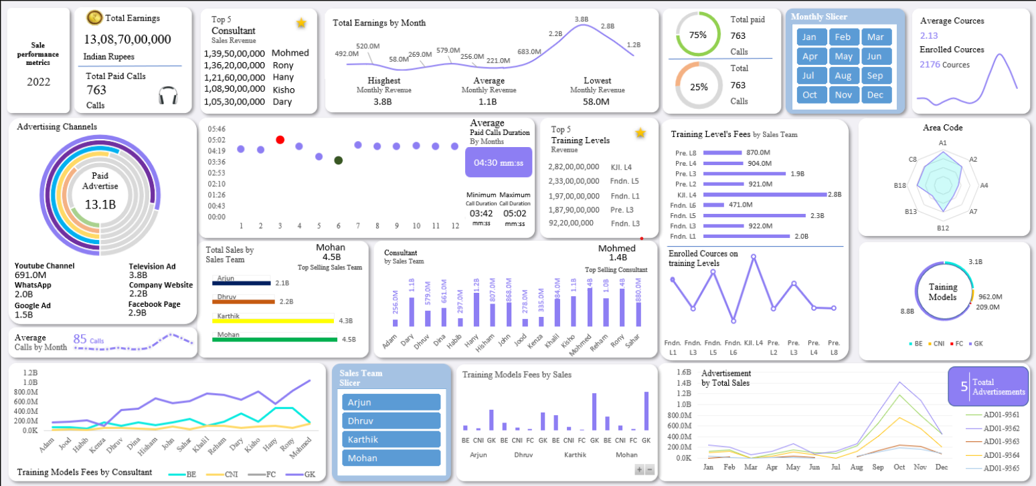
Dashboard of the sales performance

Slide 7
Thank you

